Slide 1


HYDERABAD RENTAL MARKET ANALYSIS
A Data-Driven Study of Rental Trends, Locality Insights, and Price Drivers
Presented by:
Keerthi Reddy

Slide 2
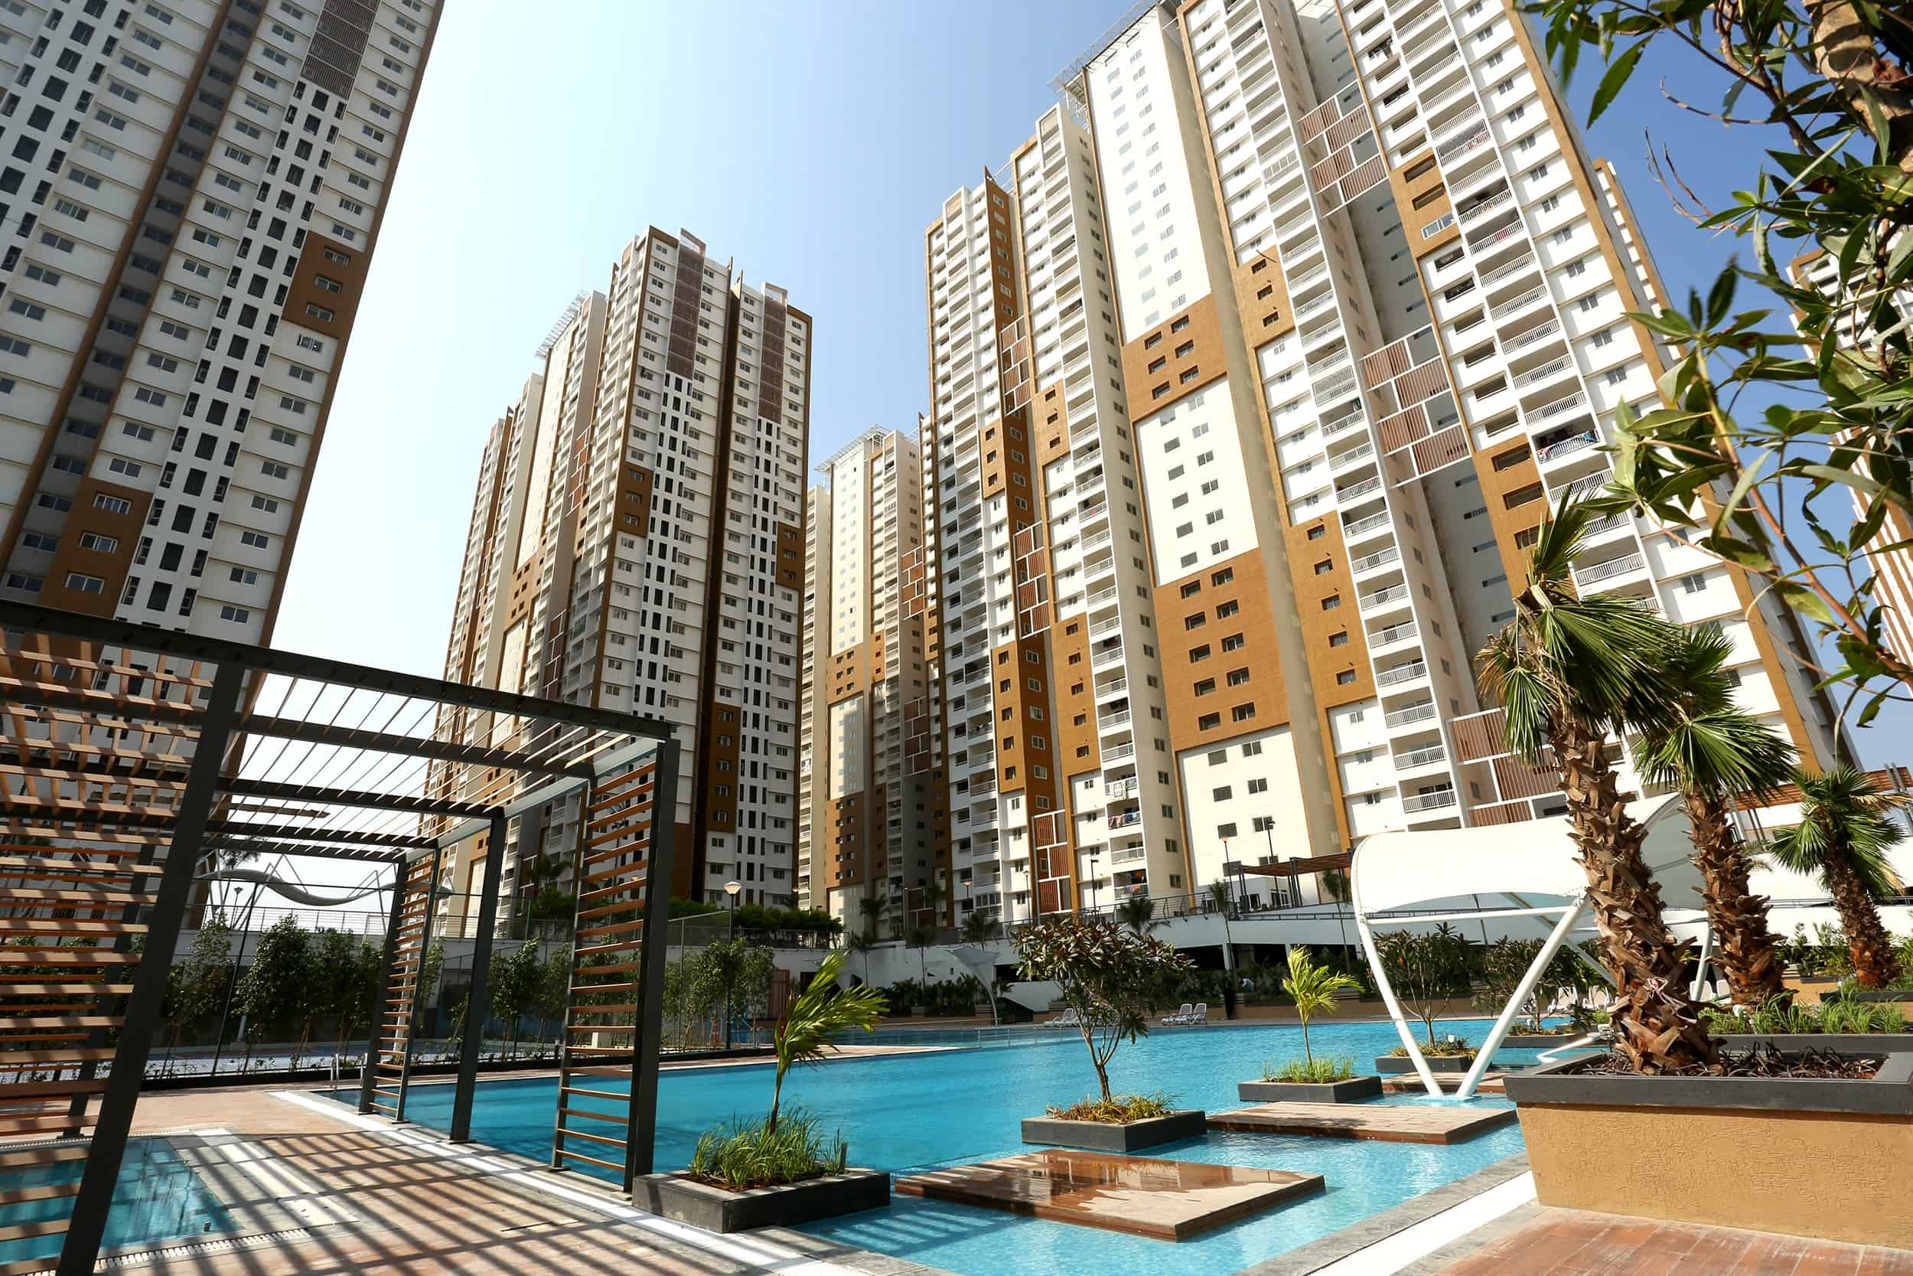
Problem Statements
Identify rental price variations across Hyderabad localities.
Analyze which property features most influence rent.
Examine the effect of furnishing and amenities on rent.
Compare rental performance across property types.
Discover correlations between area, rooms, and rent.
Support data-driven pricing and investment strategies.

Slide 3
Web Scraping for Rental Data Collection
Objective
To gather detailed and up-to-date house rental data for Hyderabad directly from online sources.
Data Source
Housing.com – Rental listings for Hyderabad.
Tools & Libraries Used
Python
Requests → To fetch webpage HTML data
BeautifulSoup → To parse and extract property details
re (Regular Expressions) → For text cleaning and pattern extraction
Process
URLs Created: Generated multiple page links (1–100) of Hyderabad rental listings.
Data Extraction: using regular expressions
Storage: Stored the collected data into structured Python lists, then exported as a CSV file

Slide 4





Data Overview
Source: Web-scraped from Housing.com
Dataset Size: 3,000 rows × 16 columns
Key Columns: No_of_Rooms, Unit_Type, Property_Category, Locality, Society_Name, Furnishing_Status, Has_Pool, Has_Gym, Has_Parking, Has_Lift, Close_to_Hospital, Power_Backup, Kids_Play_Area, Security_24x7, Price, Area
Data Cleaning Steps
Dropped unnecessary columns: Society_Name and Security_24x7
Stripped extra spaces from all column values
Converted numeric columns (Price, No_of_Rooms, Area) to integers
Removed duplicate records for consistency and accuracy
Verified and standardized data types for analysis

Slide 5
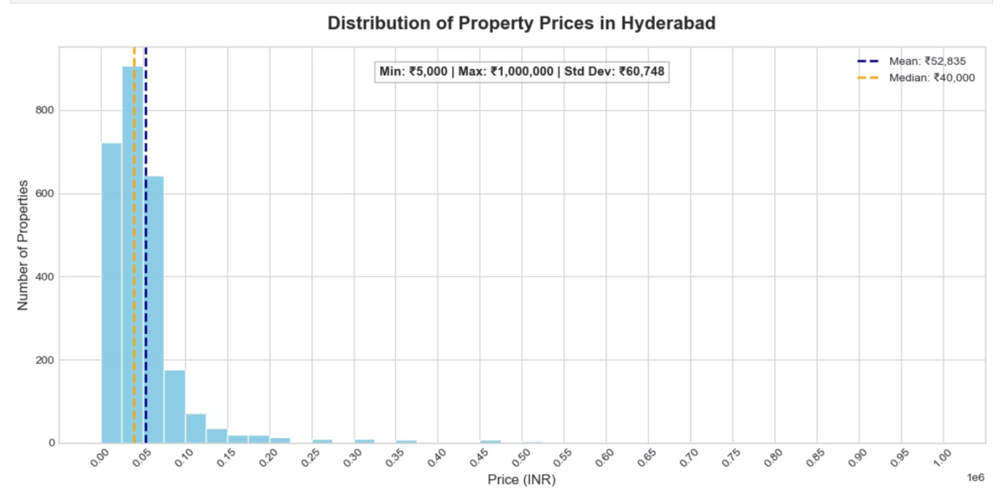
RENT ANALYSIS

Slide 6
Top 5 Expensive vs Top 5 Cheapest Properties
Top 5 Expensive Properties:
Locality
Property Category
Price (₹)
Area (sqft)
No of Rooms
Jubilee Hills
Duplex
10,00,000
6,500
5
Khaja Guda
Villa
7,50,000
6,500
4
Jubilee Hills
Independent
7,00,000
10,000
4
Kokapet
Independent
7,00,000
10,000
4
Jubilee Hills
Independent
6,00,000
10,000
5
Top 5 Cheapest Properties:
Locality
Property Category
Price (₹)
Area (sqft)
No of Rooms
Nallakunta
Independent
5,000
390
1
New Malakpet
Flat
6,000
300
1
Nallakunta
Flat
7,000
700
1
Ameerpet
Flat
7,500
420
1
Habsiguda
Independent
8,000
780
1

Slide 7
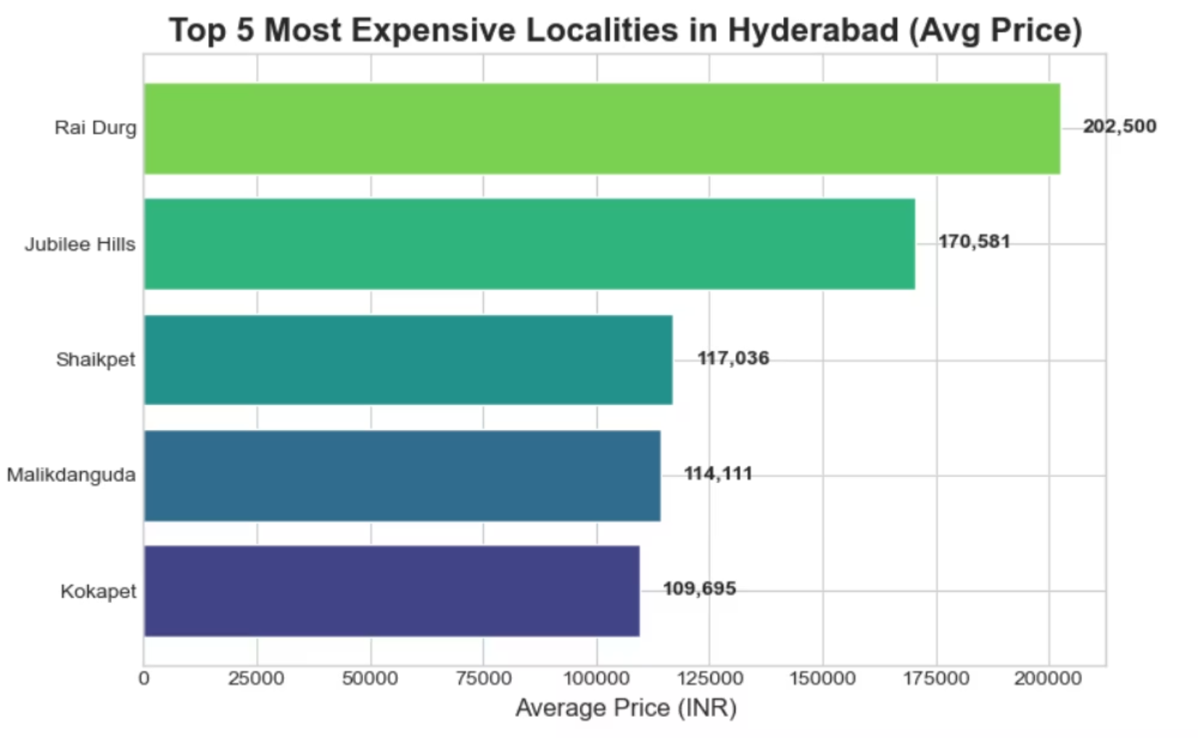
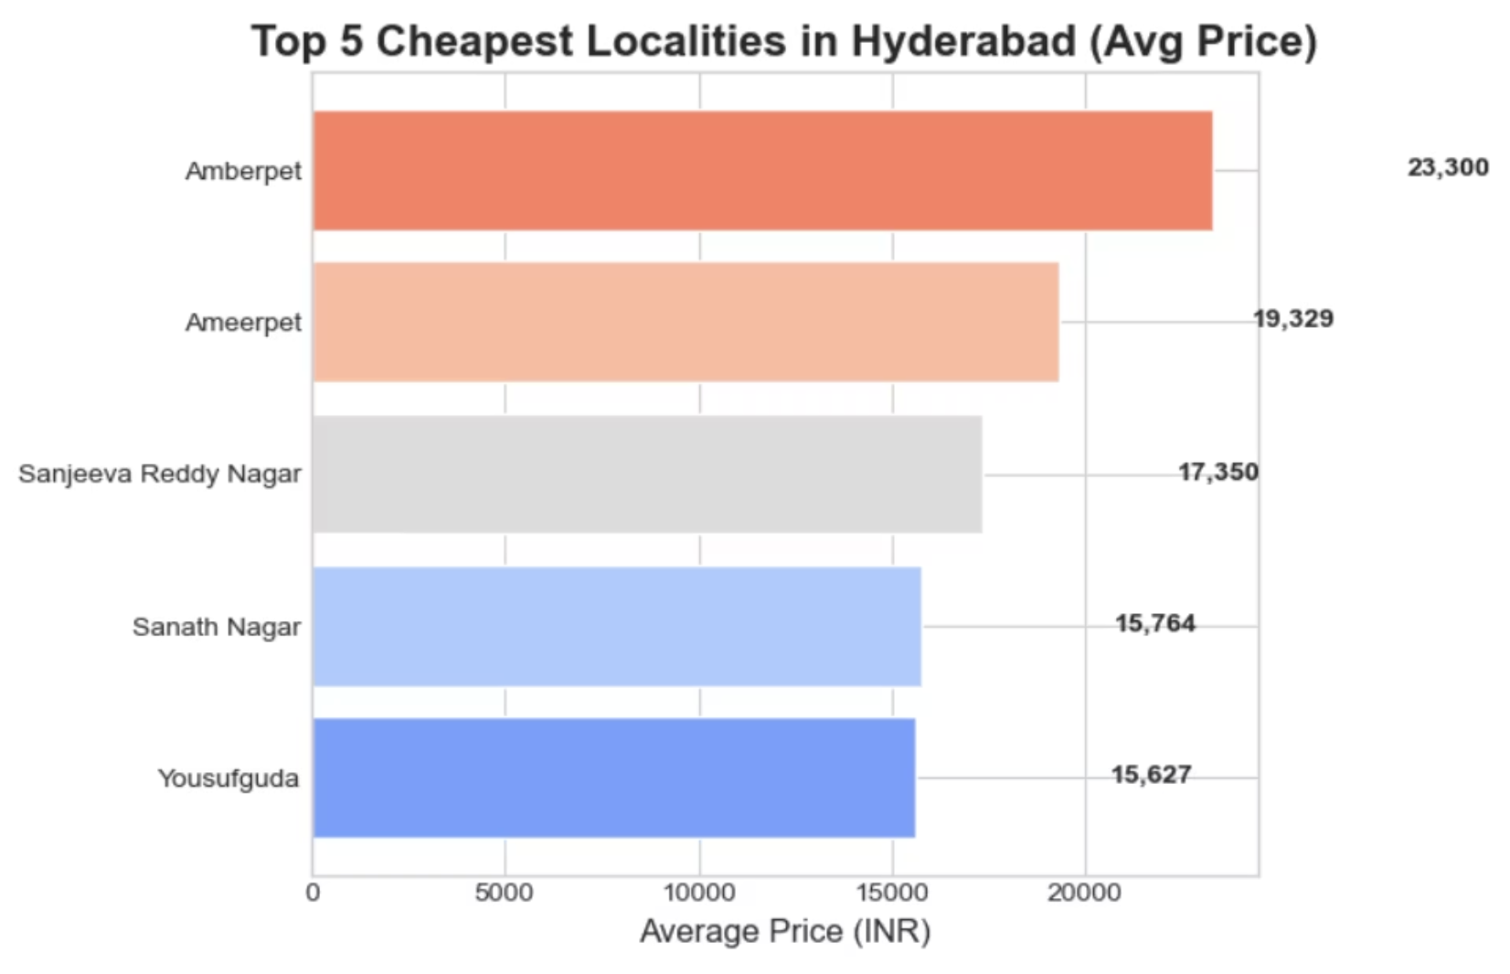
Hyderabad Rental Market: High vs Low Average Rent by Locality

Slide 8
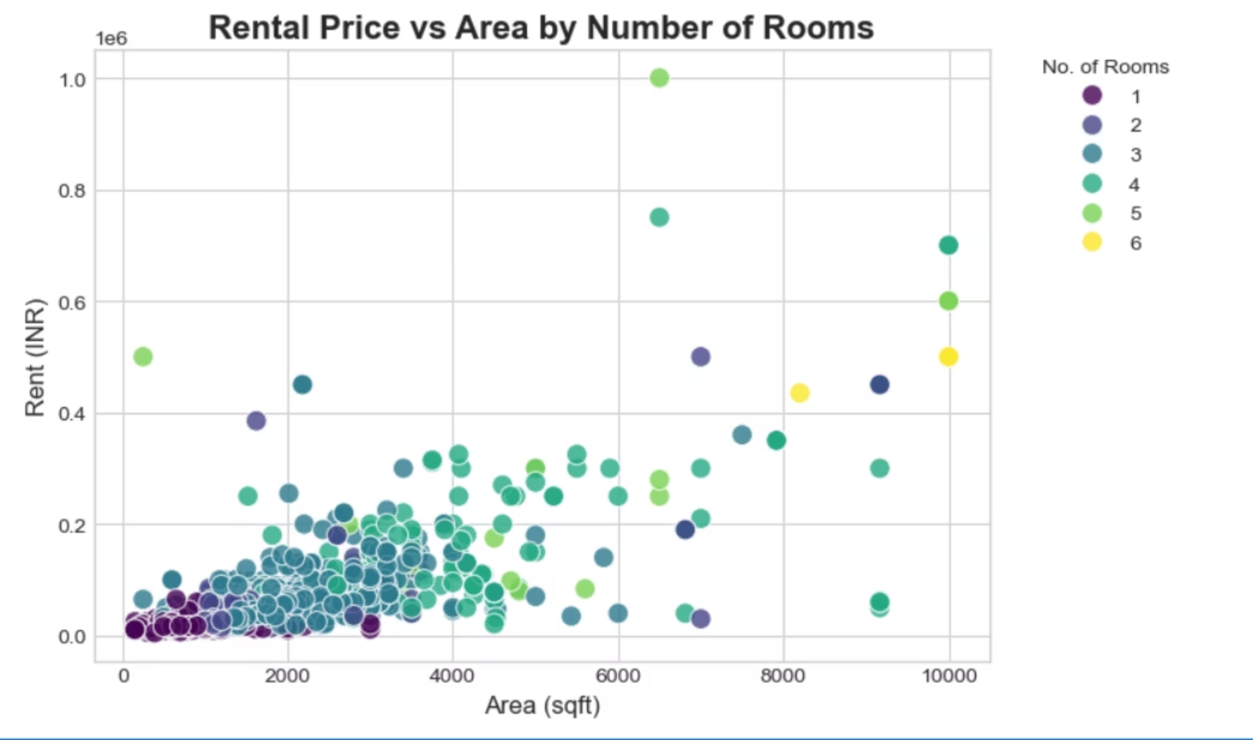

Slide 9
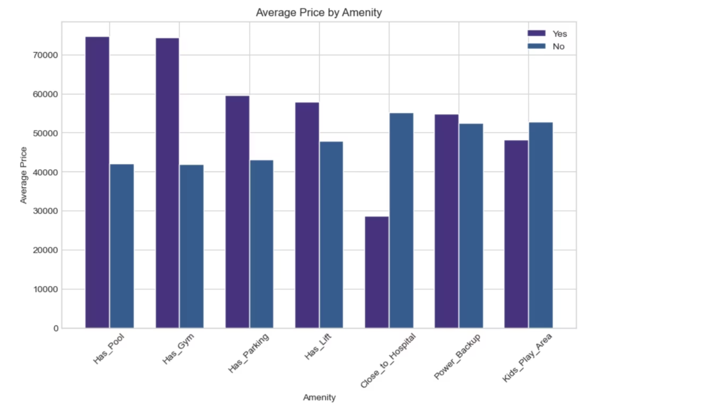
Amenities Impact on Rent

Slide 10
Key Rental Market Insights
Furnished houses cost 25–35% more than unfurnished ones.
.
Jubilee Hills , Financial District are the most expensive localities; Sanath Nagar ,Amberpet are among the most affordable.
Flats with both Gym and Parking facilities charge about 20–25% higher rents.
Power Backup and Lift availability increase rent by 10–15%.
3BHK units cost 40–50% more than 2BHK units on average.
Localities near IT hubs (Gachibowli, Madhapur, Hitech City) show the highest demand and rent per sqft.
Area_sqft and No_of_Rooms are the top numeric factors correlated with rent.

Slide 11
CONCLUSION
Hyderabad’s rental market is driven mainly by locality, space, and amenities.
Premium zones near IT corridors dominate rent prices, while well-connected outskirts offer affordable options.
Adding essential amenities and furnishing provides strong rental returns, making mid-size, amenity-rich apartments the most profitable segment for both owners and investors.

Slide 12



